Slide 1
Information for ASCI
Institutional Representatives

Slide 2
Goals
Generate awareness about ASCI awards and programs
Enhance awareness of the nomination process
Increase the number and breadth of award nominees
Support the physician-scientist career pathway

Slide 3
Using your ASCI account
In your account (the-asci.org), you can view: downloadable information on members at your institution
list of open nominations
summary of current and past membership nominees submitted for colleagues currently or formerly at your institution
list of Early-Career Award (ECA) nominees/recipients at your institution
Nonimations generally open in summer. Please look for member email notifications or check the ASCI homepage.

Slide 4
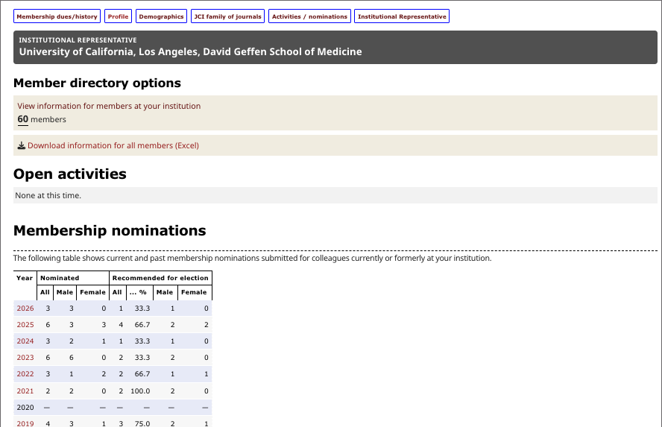
Using your ASCI account
Sample ASCI profile — Institutional Representatives view

Slide 5
Membership eligibility
Must be physicians who have “accomplished meritorious original, creative, and independent investigations in the clinical or allied sciences of medicine” and who enjoy “unimpeachable moral standing in the medical profession” (per ASCI bylaws)
May not be nominated more than three times
Must be age 50 or younger on January of the election year; for example, 2027 nominations open in summer 2026; nominee must be 50 or younger on January 1, 2027.
Nomination requires one Proposer and one Seconder (both ASCI members)

Slide 6
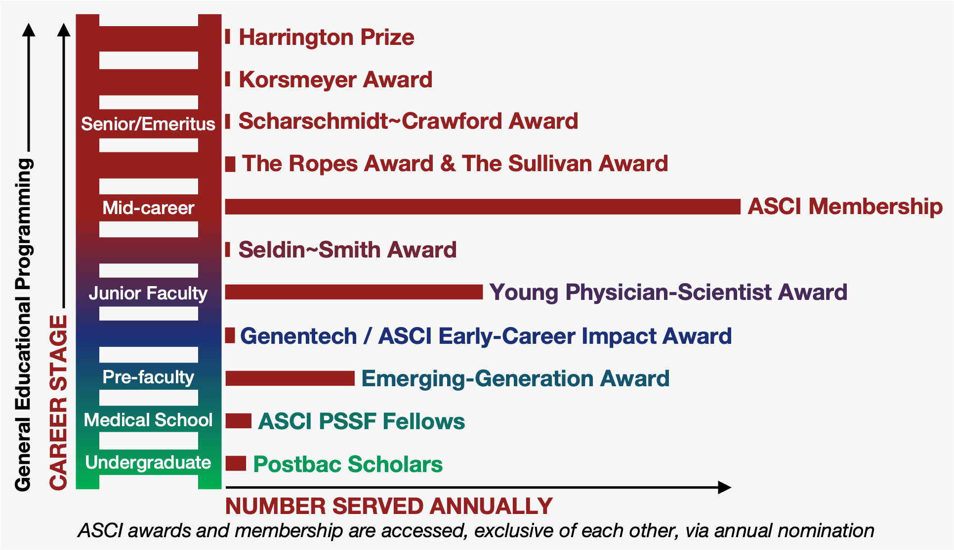
Overview of awards

Slide 7
Awards and other programs: Luminary recognition
The Harrington Prize for Innovation in Medicine
presented jointly by the ASCI and Harrington Discovery Institute;
presented to physician-scientists demonstrating innovation with
clinical potential.
The Stanley J. Korsmeyer Award
formerly the ASCI Award; renamed in 2006 in honor of Dr. Stanley J. Korsmeyer, a dedicated and accomplished physician-scientist and mentor who was the first recipient in 1998;
awarded to an ASCI member excelling in both field advancement and mentorship of emerging researchers.

Slide 8
Awards and other programs: Luminary recognition
The Bruce F. Scharschmidt and Peggy S. Crawford Translational Medicine Distinguished Lectureship and Award
founded in 2024;
celebrates physician-scientists who have made meaningful advances in diagnostics or therapeutics.

Slide 9
Awards and other programs: Mid-career recognition
The Marian W. Ropes, MD, Award
recognizes a middle-career woman ASCI member for her significant scholarly achievements.
The Louis W. Sullivan, MD, Award
recognizes a middle-career ASCI member who is underrepresented in medicine and science for their significant scholarly achievements.

Slide 10
Awards and other programs: Early-career recognition
The Donald Seldin~Holly Smith Award for Pioneering Research
honors the legacies of two esteemed members for their scientific contributions and dedicated mentorship.
recognizes an early-career physician-scientist who has demonstrated exceptional creativity and accomplishments in biomedical research.
Young Physician-Scientist Award
recognizes physician-scientists who are early in their first faculty appointment and have made notable research achievements.
provides 2 years of career-enhancing programming.

Slide 11
Awards and other programs: Early-career recognition
Genentech/ASCI Early-Career Impact Award
provides three-year research fellowships for physician-scientists who are early in their first faculty appointment (Instructor or Assistant Professor)
candiate is conducting impactful research in one of Genentech’s areas of interest. This program seeks to enhance the understanding of disease mechanisms, accelerate translational discoveries, and drive the development of cutting-edge diagnostics and therapies.
Emerging-Generation (E-Gen) Award
recognizes post-MD, pre–faculty appointment physician-scientists who are meaningfully engaged in immersive research
provides 2 years of career-enhancing programs.

Slide 12
Awards and other programs: Early-career recognition
The ASCI PSSF Fellowship
fully funded medical school gap-year opportunity for MD-only students;
rigorous, immersive training in biomedical research supervised and mentored by a PI.
The ASCI Postbaccalaureate (Postbac) Program
provides college graduates with an intensive two-year mentored laboratory research experience in an ASCI-member host laboratory;
aims to draw postbacs into the physician-scientist workforce and strengthen their MD or MD-PhD candidacy.

Slide 13
Further information
For detailed information about the awards and programs, see the ASCI website: the-asci.org/awards
For queries regarding nominations: staff@the-asci.org
For queries regarding awards/programs: programs@the-asci.org

